Slide 1

Image Generation with GANs
Ahmed Mostafa 205067
Ali Ayman 205049

Slide 2
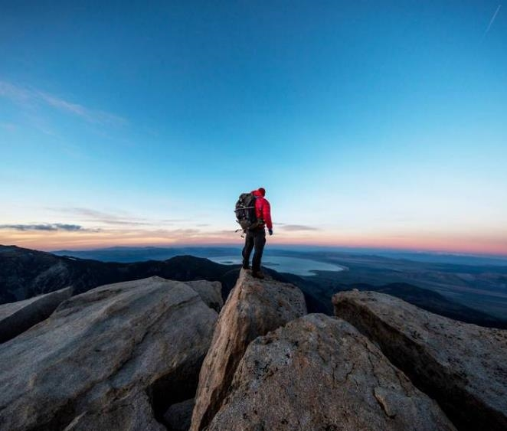

Agenda
Introduction to Image Generation with GANs
Fundamentals of Generative Adversarial Networks (GANs)
The Generator and Discriminator Architectures
Training GANs: The Adversarial Learning Process
Conditional GANs and Controlling Image Generation
Techniques for Stable GAN Training
Applications of GANs: Image-to-Image Translation
The Future of Image Generation with GANs

Slide 3
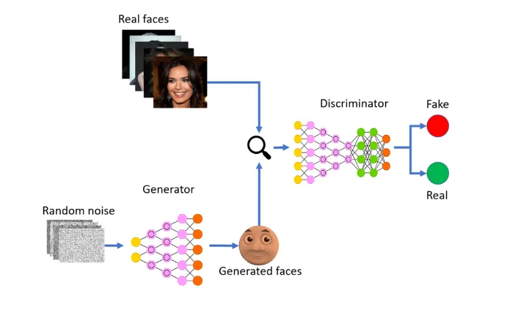
Introduction to Image Generation with GANs
In the world of artificial intelligence and machine learning, one of the most exciting and rapidly evolving fields is that of Generative Adversarial Networks (GANs). GANs have revolutionized the way we approach image generation, allowing machines to create stunningly realistic and diverse images that were once the exclusive domain of human artists and designers.
At the heart of GAN-powered image generation is a unique and ingenious approach that pits two neural networks against each other in a dynamic and ever-evolving battle. The "generator" network is tasked with creating images that are so lifelike and convincing that they can fool the "discriminator" network, which is trained to distinguish between real and synthetic images. This adversarial interplay results in the generator network continuously refining and improving its output, leading to the creation of images that are increasingly indistinguishable from the real

Slide 4
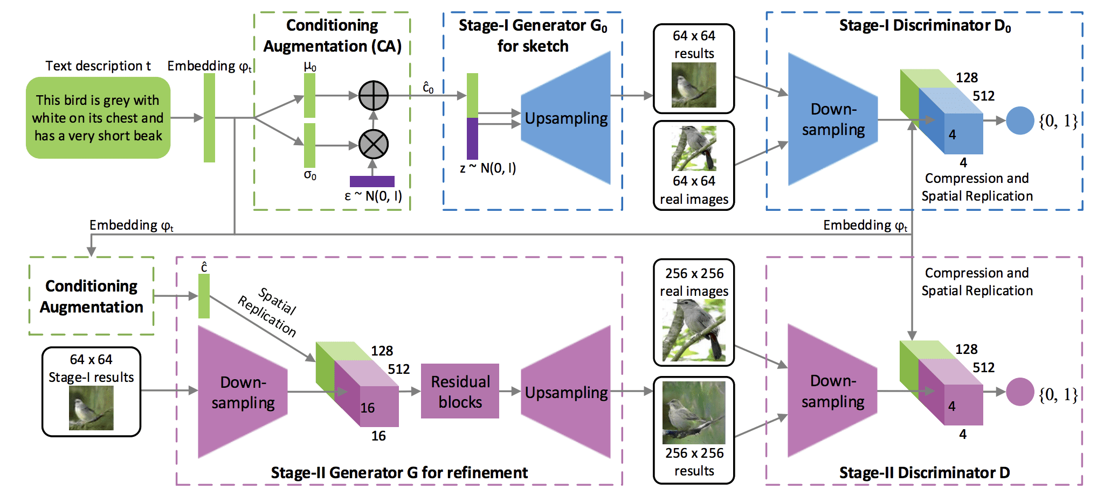
Fundamentals of Generative Adversarial Networks (GANs)
The Generator is responsible for creating synthetic images that aim to be indistinguishable from real-world data, while the Discriminator is tasked with identifying whether an input image is genuine or artificially generated. This adversarial setup pits the two networks against each other in a continuous feedback loop, where the Generator learns to create more and more convincing images, and the Discriminator becomes increasingly adept at detecting fakes. The Generator's objective is to produce images that can fool the Discriminator into classifying them as real, while the Discriminator attempts to correctly distinguish between genuine and synthetic images. Through this iterative training, the Generator learns to capture the underlying data distribution, enabling it to generate highly realistic and diverse images.

Slide 5
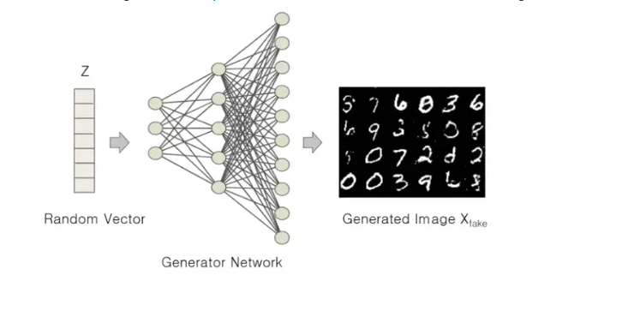
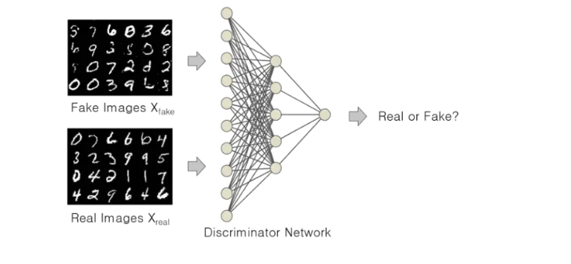
The Generator and Discriminator Architectures
The Generator is responsible for producing the synthetic, or generated, images that aim to be indistinguishable from real data. Meanwhile, the Discriminator is tasked with analyzing images and classifying them as either real or fake. The Generator network typically consists of a series of transposed convolutional layers, which learn to transform a low-dimensional input (such as a random noise vector) into a high-dimensional output in the form of an image. On the other side, the Discriminator network is often built using a convolutional neural network (CNN) architecture, similar to those used for image classification tasks. The Discriminator's role is to examine the input images and determine whether they are real (from the training dataset) or fake (generated by the Generator). As the training progresses, the Discriminator becomes more adept at distinguishing between genuine and synthetic images.

Slide 6
Training GANs: The Adversarial Learning Process
The Adversarial Setup
At the core of training Generative Adversarial Networks (GANs) is the adversarial setup between the Generator and Discriminator networks. The Generator's goal is to learn how to produce synthetic images that can fool the Discriminator into classifying them as real, while the Discriminator aims to accurately distinguish between genuine and generated images. This competition drives the continuous improvement of both networks, leading to increasingly realistic and diverse image generation.
Optimizing the Objective Function
The training of GANs is guided by an objective function that encapsulates the adversarial relationship between the Generator and Discriminator. This function is typically a min-max optimization problem, where the Generator aims to minimize the objective, while the Discriminator tries to maximize it. By iteratively updating the networks to optimize this objective function, the GAN learns to capture the underlying data distribution, enabling the Generator to produce increasingly realistic and diverse images.

Slide 7
Training GANs: The Adversarial Learning Process
The Training Procedure
The training process of a GAN involves alternating between updating the Generator and Discriminator networks. First, the Discriminator is trained on a mix of real images from the dataset and synthetic images generated by the Generator. The Discriminator learns to identify the real images and flag the generated ones as fake. Then, the Generator is trained, using the feedback from the Discriminator to improve the realism and quality of the generated images, with the goal of fooling the Discriminator.

Slide 8
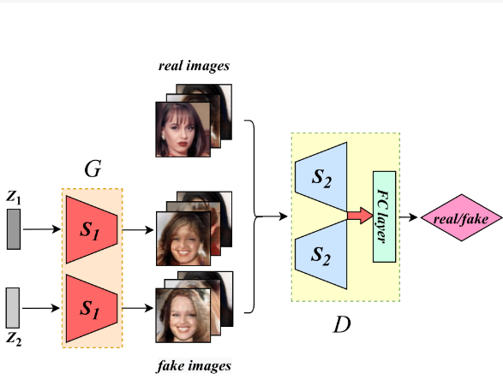
Conditional GANs and Controlling Image Generation
This is where Conditional GANs (cGANs) come into play, expanding the capabilities of traditional GANs by allowing the models to generate images based on additional input conditions. In a cGAN, the Generator and Discriminator networks are conditioned on extra information, such as class labels, text descriptions, or even other images. This conditioning process enables fine-grained control over the generated images, allowing for applications like attribute-based image synthesis, text-to-image generation, and image-to-image translation.

Slide 9
Techniques for Stable GAN Training
Architectural Innovations
Researchers have developed a range of architectural techniques to improve the stability and performance of Generative Adversarial Networks (GANs) during training.
Regularization and Normalization
Techniques like gradient penalty, layer normalization, and instance normalization have been demonstrated to help mitigate the problem of mode collapse, where the Generator learns to produce only a limited subset of the target distribution.
Balanced Training and Hyperparameter Tuning
Techniques like adaptive learning rates, gradient clipping, and careful scheduling of hyperparameter updates have shown promise in stabilizing the GAN training process.
Improved Initialization and Conditioning
Careful weight initialization, such as using orthogonal or Kaiming initialization, as well as proper conditioning of the input noise and the network architectures, can help avoid the vanishing or exploding gradients that can occur during training.

Slide 10
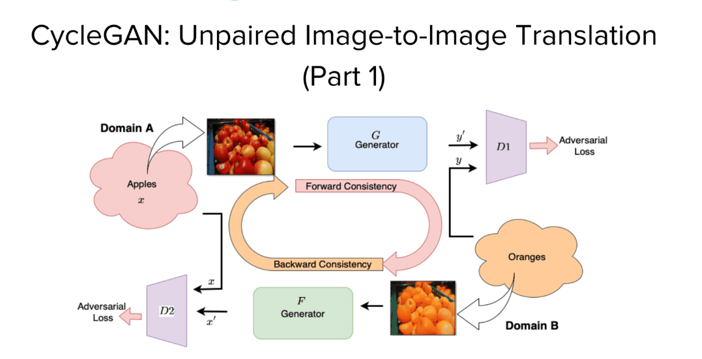
Applications of GANs: Image-to-Image Translation
Multimodal Image Translation: GANs can translate a single input image into multiple possible outputs, allowing for the exploration of different styles and variations1.
Super-Resolution: GANs can enhance the resolution of images, translating low-resolution inputs into high-resolution outputs, which is particularly useful in medical imaging and satellite imagery1.
Object Transfiguration: This involves changing the appearance of specific objects within an image, such as altering the breed of a dog in a photograph1.

Slide 11
Applications of GANs: Image-to-Image Translation
Medical Image Analysis: GANs are used for tasks like PET-CT translation, correction of MR motion artifacts, and PET image denoising, improving the quality and utility of medical images2.
Style Transfer: GANs can apply the style of one image to the content of another, effectively translating the image into a different artistic style1.
Synthetic Data Generation: For training machine learning models, GANs can generate varied, realistic images that augment datasets, especially when real data is scarce or privacy is a concern1.

Slide 12
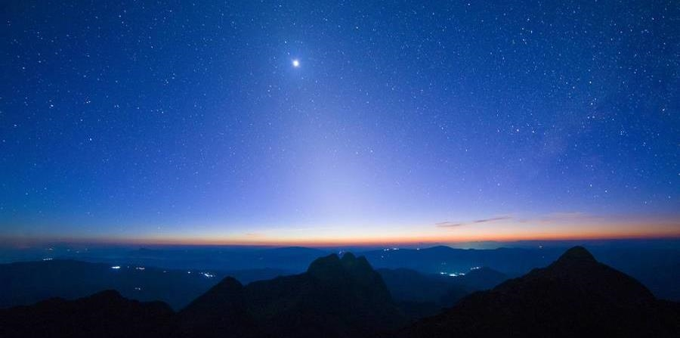

Thank you
AI application
Dr. weal Badawi
Ahmed Mostafa
Ali Ayman

